Slide 1
Ness Digital Engineering
Ness Tech Days - A Virtual Technology Conference
17th, 22nd & 23rd January 2019
Private & Confidential

Slide 2

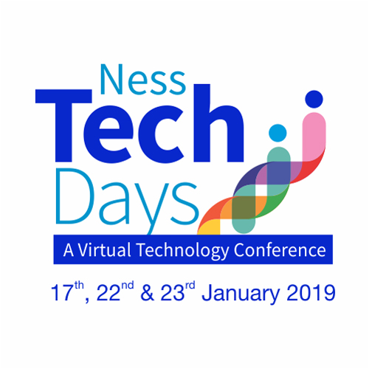
Powered by
Chief Technology Office
Topic: An Introduction to Scaled Agile Framework (SAFe)
Date: 17-01-2020
Presenter: Sourav Kumar Soni
Senior QA Engineer

Slide 3

Challenges | safe | art | house of lean | ness | SAFE Across globe | pros & cons
The Business / Organizational Challenges
Adoption of Agile methods in large enterprises lead to coordination & prioritization challenges.
One of the ‘flaws’ of standalone Scrum is that teams may be more efficient and productive, but they often may not be doing the most valuable thing for the enterprise because they lack the system-wide visibility.
Other important business challenges faced are:
Sustain release cadence
While delivering quality software
Solutions available to enterprises include SAFe , LeSS and Spotify’s Tribes-and-Guilds

Slide 4
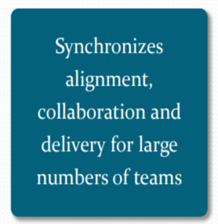
Challenges | safe | art | house of lean | ness | SAFE Across globe | pros & cons
Introducing the Scaled Agile Framework or SAFe
SAFe for Lean Enterprises is a knowledge base of proven, integrated principles, practices, and competencies for Lean, Agile, and DevOps. More than the sum of its parts, SAFe is a scalable and configurable framework that helps organizations deliver new products, services, and solutions in the shortest sustainable lead time.
SAFe is a prescriptive method that outlines a highly structured framework to adopt and operate an Agile value stream in an enterprise setting. It gives detailed guidance for work at the enterprise Portfolio, Value Stream, Program, and Team. It is designed to meet the needs of all stakeholders within an organization.
Core Values
Transparency
Built in Quality
Alignment
Program Execution

Slide 5
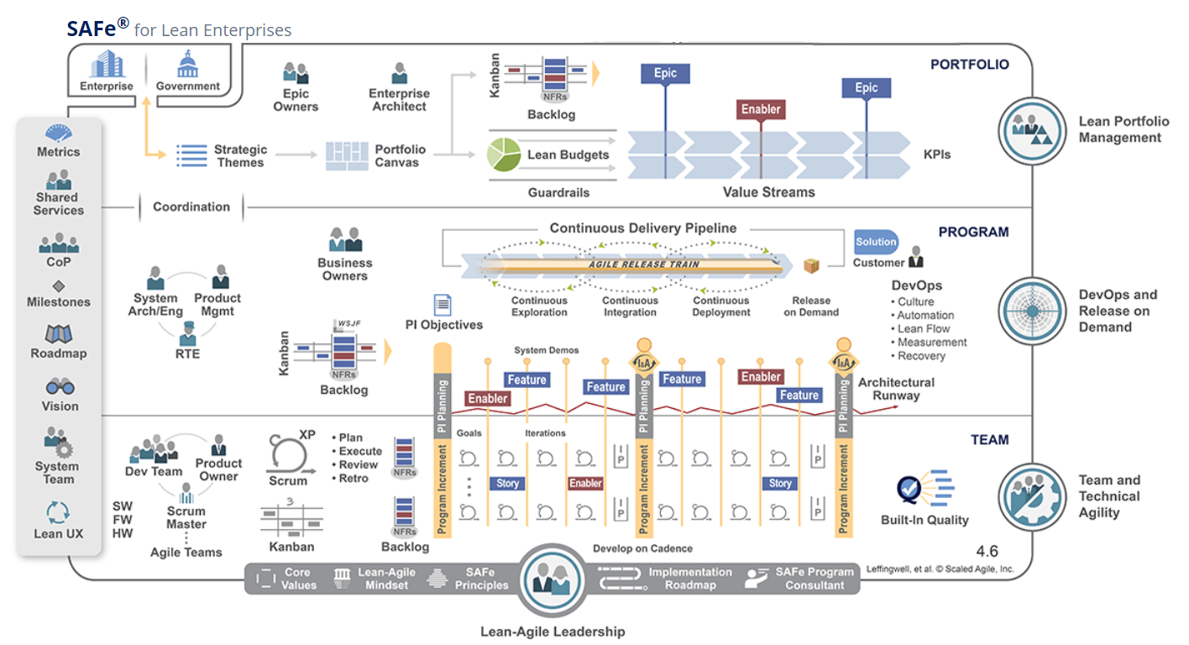
Challenge | safe | art | house of lean | ness | SAFE Across globe | pros & cons
The SAFe Framework
© Scaled Agile, Inc.
Notes:
SAFe describes three levels in the organization: portfolio, program, and team. Multiple teams might be working together with SAFe to develop iterations, but they all follow the same timeline, cadence and delivery dates. This is essential for keeping everyone on track and keeping the project moving forward.

Slide 6
Challenge | safe | art | house of lean | ness | SAFE Across globe | pros & cons
The SAFe Framework: Team
Valuable, fully tested software increments every two weeks
Empowered, self-organizing, self-managing cross functional teams
Teams operate under program vision, architecture and user experience guidance
Value delivery via User Stories
© Scaled Agile, Inc.

Slide 7
Challenge | safe | art | house of lean | ness | SAFE Across globe | pros & cons
The SAFe Framework: Program
Aligned to a common mission via a single backlog
Common sprint lengths and estimating
F2F release planning cadence for collaboration, alignment, synchronization and assessment
Value delivery via Features and Benefits
© Scaled Agile, Inc.

Slide 8
Challenge | safe | art | house of lean | ness | SAFE Across globe | pros & cons
The SAFe Framework: Portfolio
Centralized strategy, decentralized execution
Lean –Agile budgeting empowers decision makers
Kanban systems provide portfolio visibility and WIP limits
Value description via Business and Architectural Epics
© Scaled Agile, Inc.

Slide 9
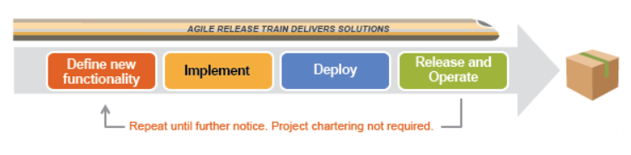
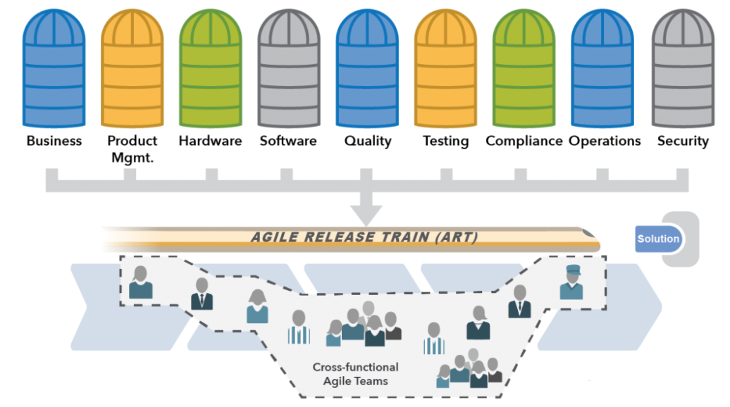
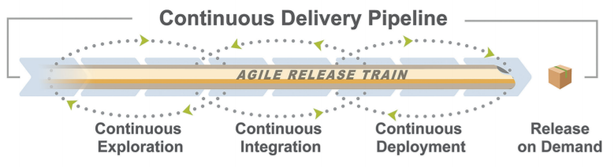
Challenge | safe | art | house of lean | ness | SAFE Across globe | pros & cons
Alignment through Agile Release Trains(ART)
The Agile Release Train (ART) is a long-lived team of Agile teams, which, along with other stakeholders, incrementally develops, delivers, and where applicable operates, one or more solutions in a value stream.
Value flows through four dimensions of the CD Pipeline: Continuous Exploration, CI, CD and Release on Demand.
ARTs are cross-functional and have all the capabilities—software, hardware, firmware, and other—needed to define, implement, test, deploy, release, and where applicable, operate solutions. An ART delivers a continuous flow of value.
© Scaled Agile, Inc.

Slide 10
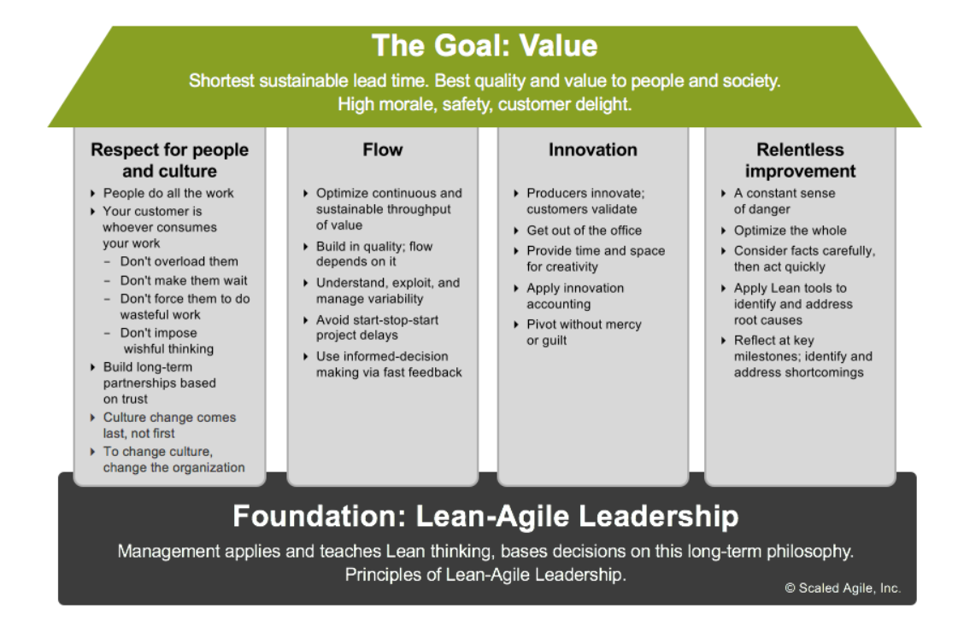
Challenge | safe | art | house of lean | ness | SAFE Across globe | pros & cons
SAFe Builds on House of Lean

Slide 11
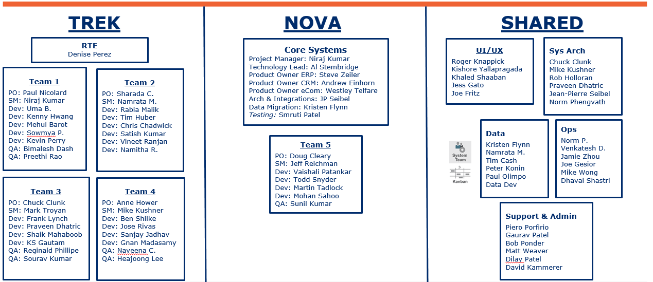
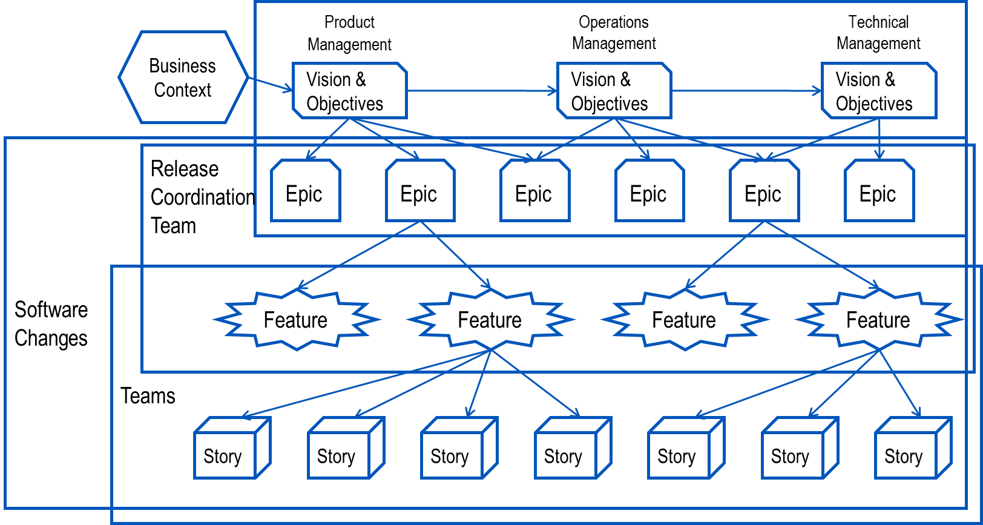
Challenge | safe | art | house of lean | ness | SAFE Across globe | pros & cons
Examples of SAFe Adopters at Ness
HERE Technologies
Solar Turbines
GS1 US
Formerly Navteq, HERE is a leading map data company owned by Daimler, BMW and Audi). Ness jointly launched two centers in November 2007 and pioneered early versions of SAFe as Agile was being adopted across Nokia.
Our teams participate along with other teams to Release Planning “Town Hall” Meetings in well planned two day events with all stakeholders.
The team members of the biggest and most rapidly growing IoT project at Ness KDC (30 Teams) meet quarterly with their colleagues from San Diego and Novazzano.
After the Californian edition held in January, the expectations were set high for the organizers. However, Nessians do not fear of challenges. Three days long event included planning sessions as well as several teambuilding activities.
GS1 US collaboratively works with industries and stakeholders to address challenges and meet goals through standards-based solutions.
SAFe has been recently implemented and completed 5 Program Increments(PI’s) with successful working Software delivered to customers and stakeholders.

Slide 12
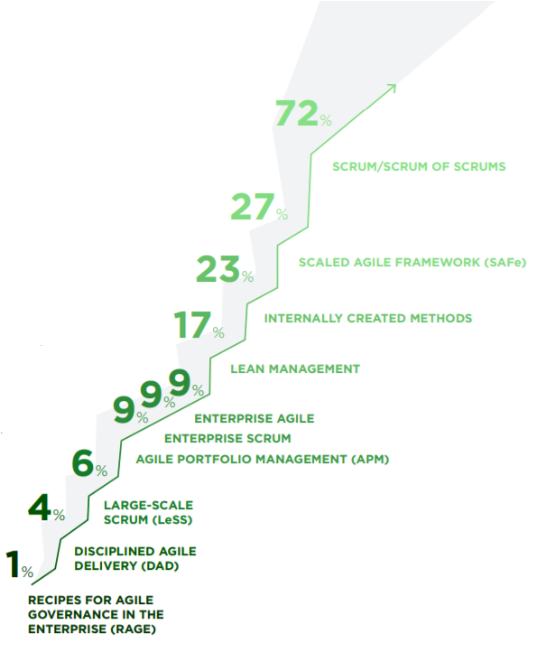
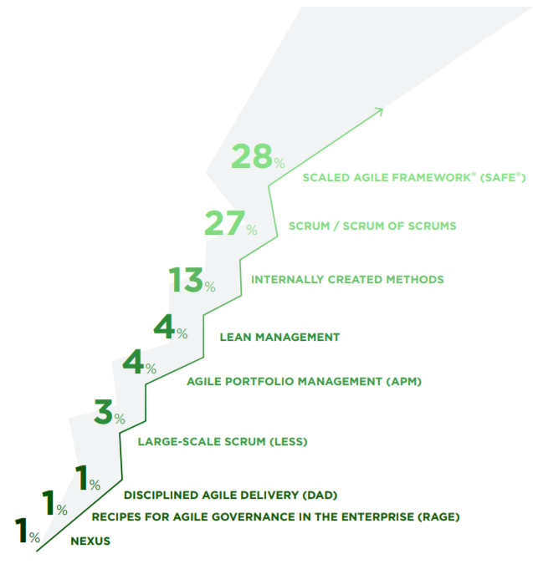
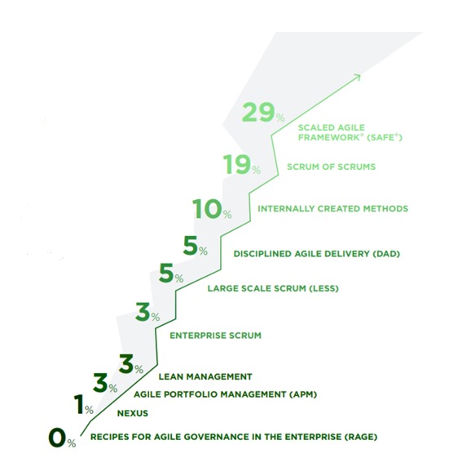
Challenge | safe | art | house of lean | ness |SAFE Across globe | pros & cons
Use of SAFe Across Globe (A State of AGILE Survey)
10th State of Agile Survey
11th State of Agile Survey
12th State of Agile Survey
© #StateOfAgile

Slide 13
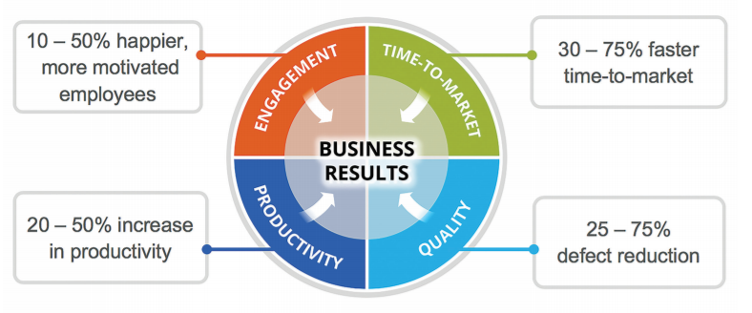
Challenge | safe | art | house of lean | ness | SAFE Across globe | pros & cons
Challenges vs Benefits
One Size Fits Some
Size != Value
New Things Start Small
Test Data Management
Automation
Defects Tracking
Identifying initial Epics
Ensuring Code Quality
© Scaled Agile, Inc.

Slide 14
Challenge | safe | art | house of lean | ness | SAFE Across globe | pros & cons
Pros and Cons
Pros
Cons
SAFe has been criticized for being too prescriptive, not allowing teams as much flexibility in process decision
Highly approachable in usable form
Grounds Agile practices in an enterprise context
Scalable to larger enterprises
Coordination and interdependency
Alignment with the multiple teams
Wide angle of the architecture with the Roadmap
Transparency in the system
Encourages Continuous Integration and Continuous Development (CI/CD)
The bigger picture, top-down approach of SAFe removes front-line players, including developers, testers and product owners, from the decision-making process
Possesses similarities similar to Waterfall if it is too much of SAFe
Time-slotted iterations

Slide 15
Sourav Kumar Soni
Senior QA Engineer , GS1 US

